Slide 1

Artificial Intelligence and Machine Learning
How Computers Learn from Data and Change Everyday Life
Artem Cherevatenko CS 131 Spring 2026

Slide 2
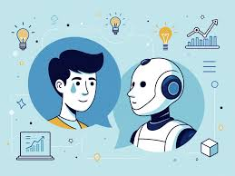
What is Artificial Intelligence?
Artificial intelligence, or AI, is the ability of computers to perform tasks that normally require human intelligence.
AI can analyze information, recognize patterns, solve problems, and make decisions.
It is used in many everyday technologies such as voice assistants, navigation apps, recommendation systems, and chatbots.
AI is becoming an important part of modern life because it helps automate tasks and improve efficiency.

Slide 3
What is Machine Learning?
Machine learning is a branch of artificial intelligence.
Instead of following only fixed rules, a machine learning system learns from data.
It finds patterns in examples and uses those patterns to make predictions or decisions.
The more relevant training data it receives, the better the model can perform.
Data
Training
Model
Prediction

Slide 4
How Computers Learn from Data
Machine learning models are trained using examples.
During training, the computer receives data and looks for patterns in that data.
For example, if a model is shown many images labeled “cat” and “dog,” it can learn the difference between them.
After training, the model can analyze a new image and predict whether it shows a cat or a dog.
Training images
Labels
Learning patterns
New image prediction

Slide 5
Types of Machine Learning
Supervised Learning
Uses labeled data to learn patterns and make predictions.
Unsupervised Learning
Finds hidden patterns or groups in data without labels.
Reinforcement Learning
Learns through trial and error by receiving rewards or penalties.
Type | Description | Example
Supervised Learning | Learns from labeled data | Spam detection
Unsupervised Learning | Finds patterns without labels | Customer grouping
Reinforcement Learning | Learns through rewards and mistakes | Game-playing AI

Slide 6
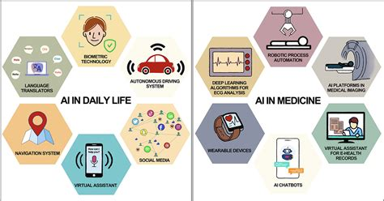
Real-World Applications of AI and Machine Learning
AI and machine learning are used in many areas of daily life.
Recommendation systems suggest videos, music, and products based on user behavior.
Navigation apps use AI to analyze traffic and suggest faster routes.
Banks use machine learning to detect unusual transactions and possible fraud.
Healthcare systems can help doctors analyze medical images and identify diseases.
Chatbots and virtual assistants can answer questions and support users.

Slide 7
Benefits and Risks of AI and Machine Learning
Benefits | Risks
Faster data processing | Bias in training data
Automation of repetitive tasks | Privacy concerns
Better predictions and recommendations | Misinformation
Improved efficiency in many industries | Possible job displacement
AI can bring major advantages, but it must be used carefully and responsibly.

Slide 8
Conclusion
Artificial intelligence and machine learning are transforming the way people live and work.
These systems learn from data and help solve real-world problems.
AI can improve efficiency, accuracy, and convenience in many fields.
However, it is important to use these technologies responsibly and understand their limitations.
In the future, AI and machine learning will likely become even more important in everyday life.
Thank you for watching.

